Slide 1
Isolation aware smp_call_function/queue_work_on APIs
Marcelo Tosatti (Red Hat)
CPU Isolation MC

Slide 2
Situation with system using CPU isolation
A number of callpaths which can interrupt isolated CPUs exist, reliance on userspace behaving nicely for interruptions to not occur.
Guarantee: If distinct interference sources align in time, interference on isolated CPU might sum up (off-topic?).

Slide 3
Proposed changes
Some of those callpaths are executed from userspace and can therefore return errors.
Introduce a new cpumask "block_interf_cpumask", with a bit set for the CPUs which should have such interferences blocked.
Introduce _fail variants of functions that interrupt CPUs, with the variant checking whether CPU is marked as “block inferferences” and returns an error.
For smp_call_function* family, stop_machine*, queue_work*

Slide 4
Proposed changes pt 2
block_interf_cpumask written from userspace, after system initialization (initialization might require code execution on interference blocked CPUs,for example MTRR initialization, resctrlfs initialization, MSR writes, ...).

Slide 5
Pattern 1
block_interf_read_lock(); (per-CPU RWSEM)
...
err = smp_call_func_single_fail();
...
block_interf_read_unlock();
If (ret)
return err to userspace

Slide 6
Pattern 2
block_interf_read_lock(); (per-CPU RWSEM)
...
int cpu = get_target_cpu();
if (cpu_is_blocked_interf(cpu))
return error to userspace
…
Code to interrupt cpu
...
block_interf_read_unlock();

Slide 7
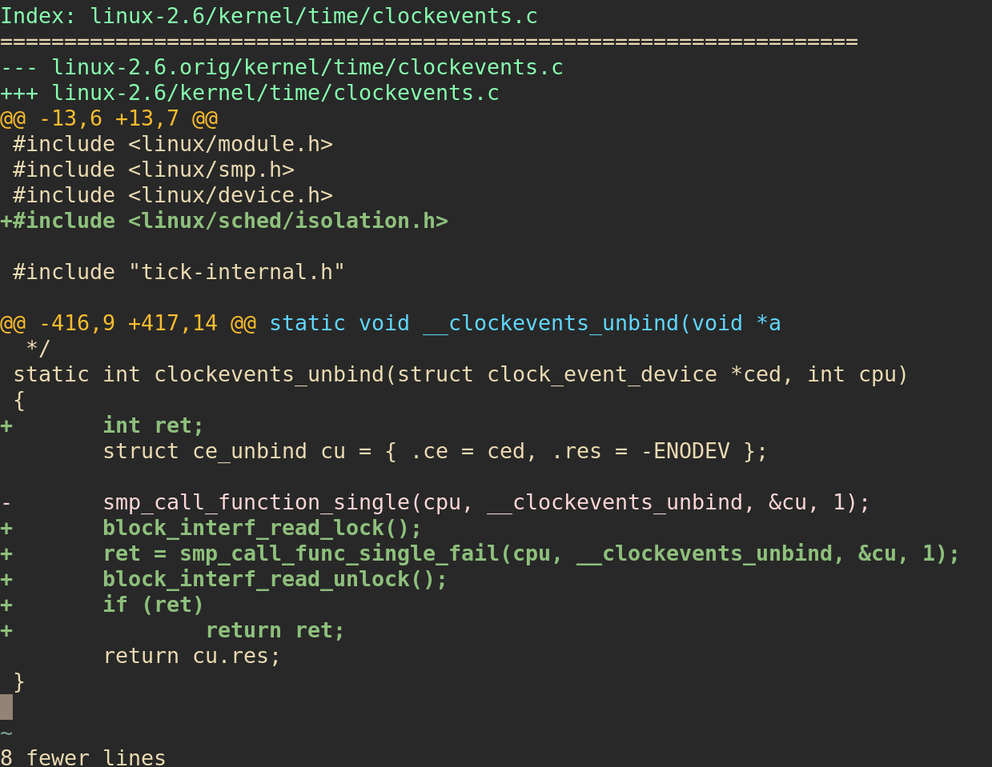

Slide 8
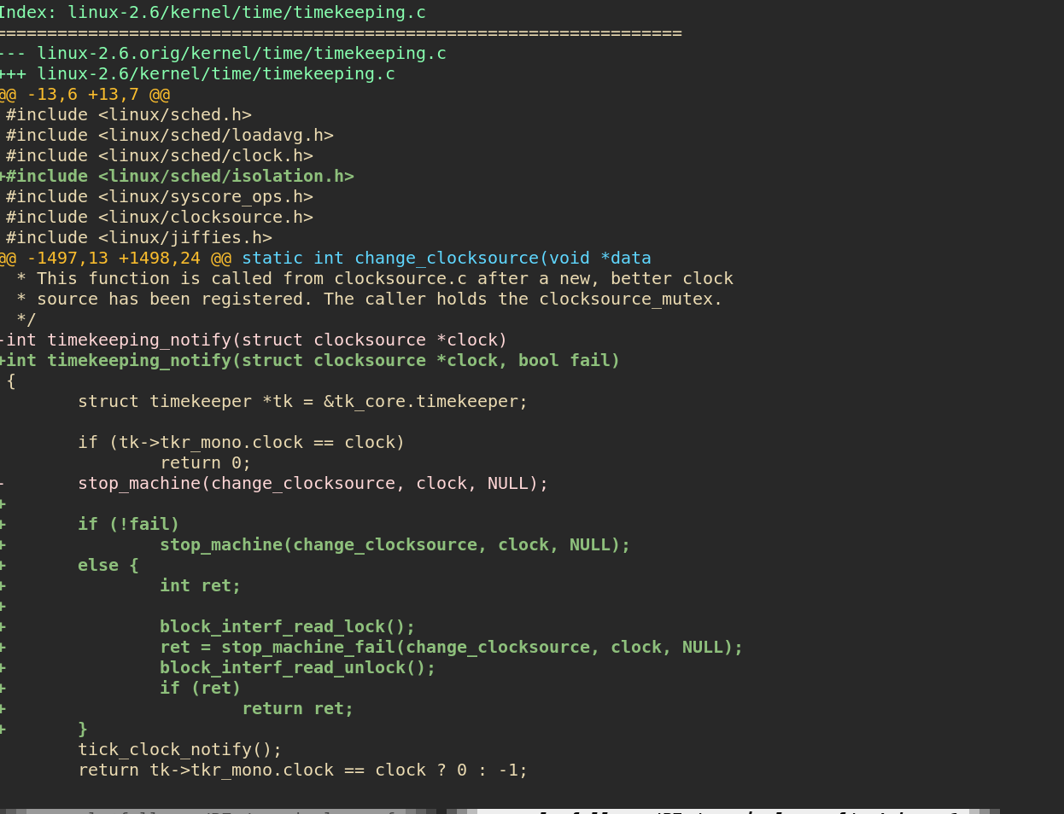

Slide 9
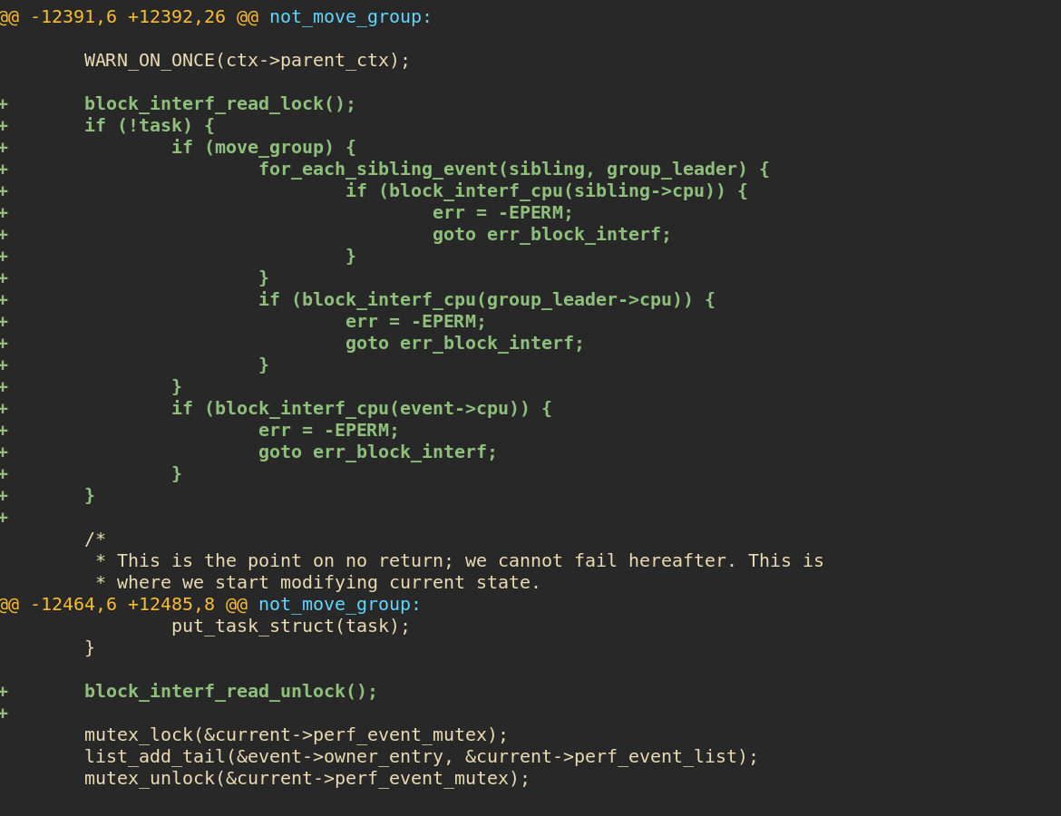
Situation with system using CPU isolation

Slide 10
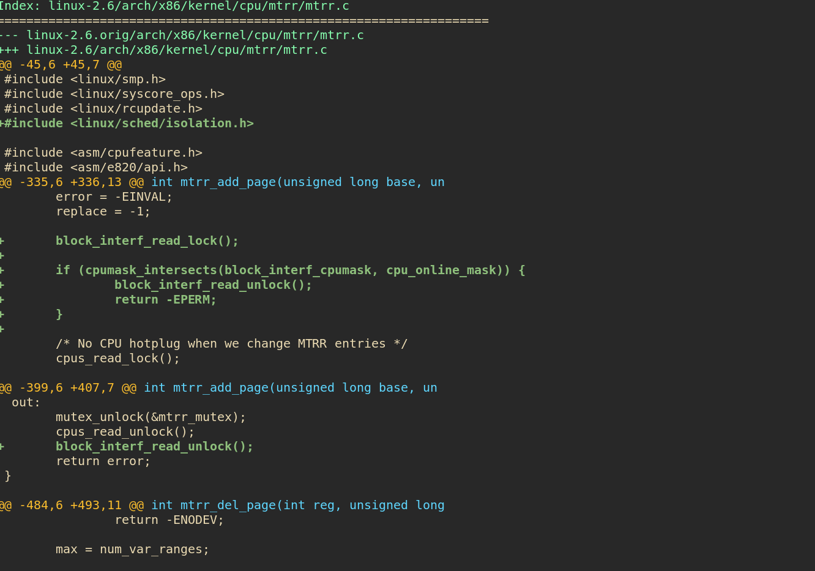
Situation with system using CPU isolation

Slide 11
Some discussion topics
Location for the cpumask to be exposed to userspace?
Others?

